Slide 1
Scala for Big Data: The Big Picture
Azure Functions * Data Bricks * Data Factory * Data Lake Gen2
Anna-Maria Wykes Software & Data Engineer

Slide 2
Who am I?
Software Engineer with 14 years’ experience, currently working with Scala, Kafka and various cloud tech at OVO Energy.
Prior to this I spent over 2 years working for a Microsoft Partner, leading a cutting-edge Data Science
Project, aided by a variety of Azure tools, including Data Factory, Data Lake Gen2 and AKS.
I have a passion for Data and strive to bring the worlds of Software Development and Data Science
closer together. Other areas of interest include UX, Agile methodologies, and helping to organize/run local
Code Clubs
@annawykes
https://www.linkedin.com/in/anna-maria-wykes-31939454/

Slide 3
Agenda: What are we going to do………
A BIT OF THEORY
Scala overview
Who uses it
Popular software written in Scala
Functional Programming
PRACTICAL
Scala basics
Read Data from XML source using Azure Function and transform to JSON
Write JSON Data in its Raw State to Data Lake Gen2 folder
Refine and Transform data using Azure Data Bricks & Azure Data Factory

Slide 4
What is Scala
In its entity, Scala is a programming language that combines two quite distinct programming paradigms, containing the features of both object-oriented and function-oriented languages
Scala's static types help avoid bugs in complex applications, and its JVM and JavaScript runtimes let you build high-performance systems with easy access to huge ecosystems of libraries
What is Scala used for? A lot of things, ranging from machine learning to web apps. As a high-level general purpose language, Scala boasts an extensive range of possible applications. Scala allows developers to make good use of standard JVM features and Java libraries

Slide 5



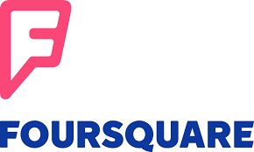


Who Uses scala

Slide 6
Software written in scala

Slide 7
Scala and Big Fast Data
“Scala has taken over the world of “Fast” Data”
Which is what some are calling the next wave of computation engines that rely more on the speed of data processing rather than the size of the batch, and the ability to process event streams in real-time.
Several prominent examples of that movement are Spark, Scalding, Kafka (including Kafka Streams), and Samza, which are rapidly gaining awareness and use

Slide 8
But still, why bother….
Professionals want to learn and use transferable, portable skills in their day job
Scala is multipurpose, meaning you can use if for anything from a simple web app to ML
Provides the opportunity to learn Functional Programming, allowing for easy transition into other languages such as Haskell, F# and even Erlang if you’re crazy enough
It is Type safe
There’s a pool of well paid Jobs
It has a solid community behind it

Slide 9
Type Safety
Type safety means that the compiler will validate types while compiling, and throw an error if you try to assign the wrong type to a variable

Slide 10
Types safety means you can’t turn a cat into a dog

Slide 11
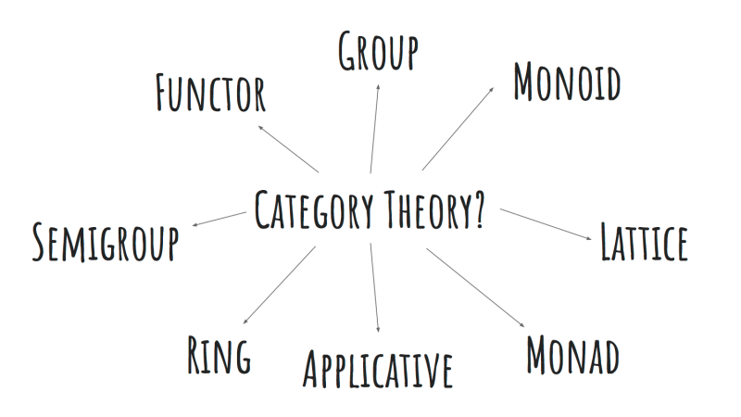
Functional Programming
In computer science, functional programming is a programming paradigm—a style of building the structure and elements of computer programs—that treats computation as the evaluation of mathematical functions and avoids changing-state and mutable data

Slide 12
Apache Spark
Apache Spark is an open-source distributed general-purpose cluster-computing framework. Spark provides an interface for programming entire clusters with implicit data parallelism and fault tolerance

Slide 13
Basics of Scala
Objects and Classes
Option
Lists
Map & FlatMap
Fold & Reduce
For Comprehensions

Slide 14
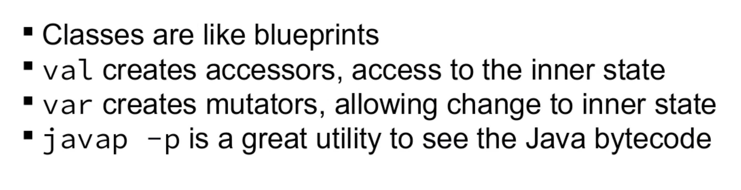
Objects and Case classes

Slide 15
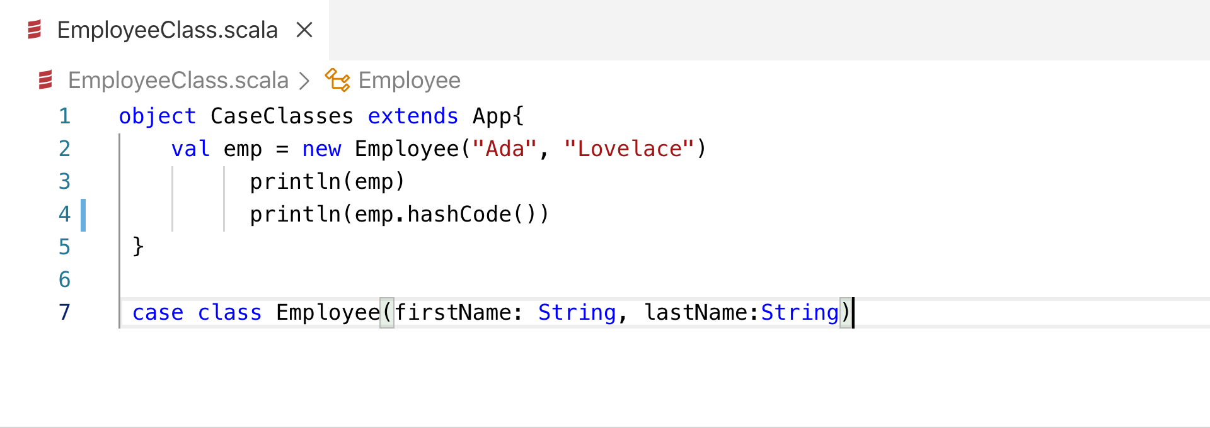
ObjecTs and Classes

Slide 16
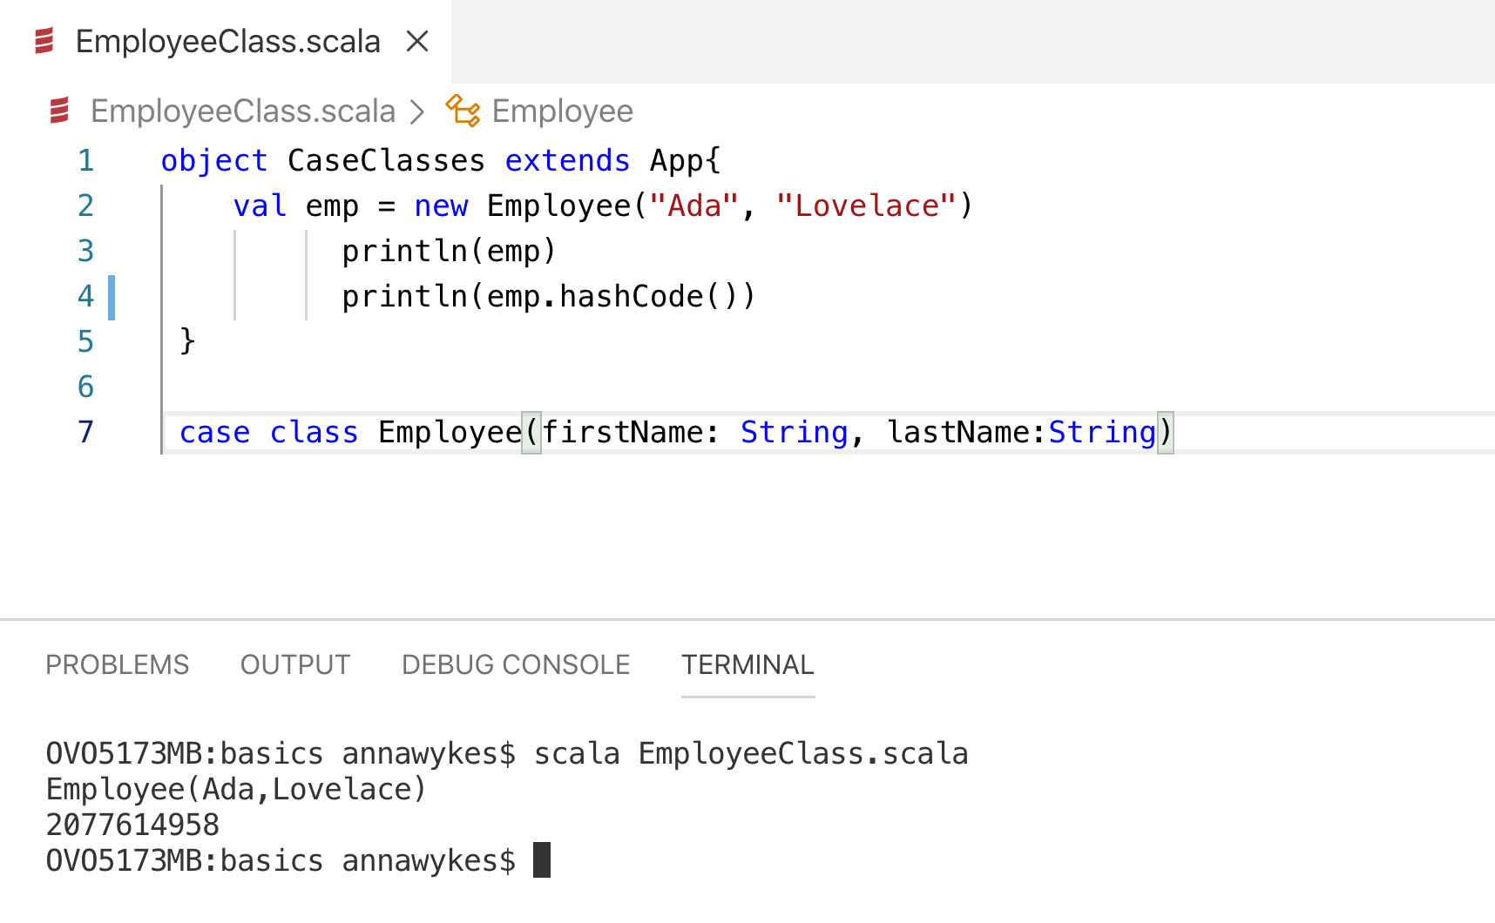

Slide 17
Options
“I call it my billion-dollar mistake. It was the invention of the null reference in 1965” — Tony Hoare, 2009
A Scala Option holds zero or one element of a type. This means that it is either a Some[T] or a none object. One place we get an Option value is through the get() method for a Map

Slide 18
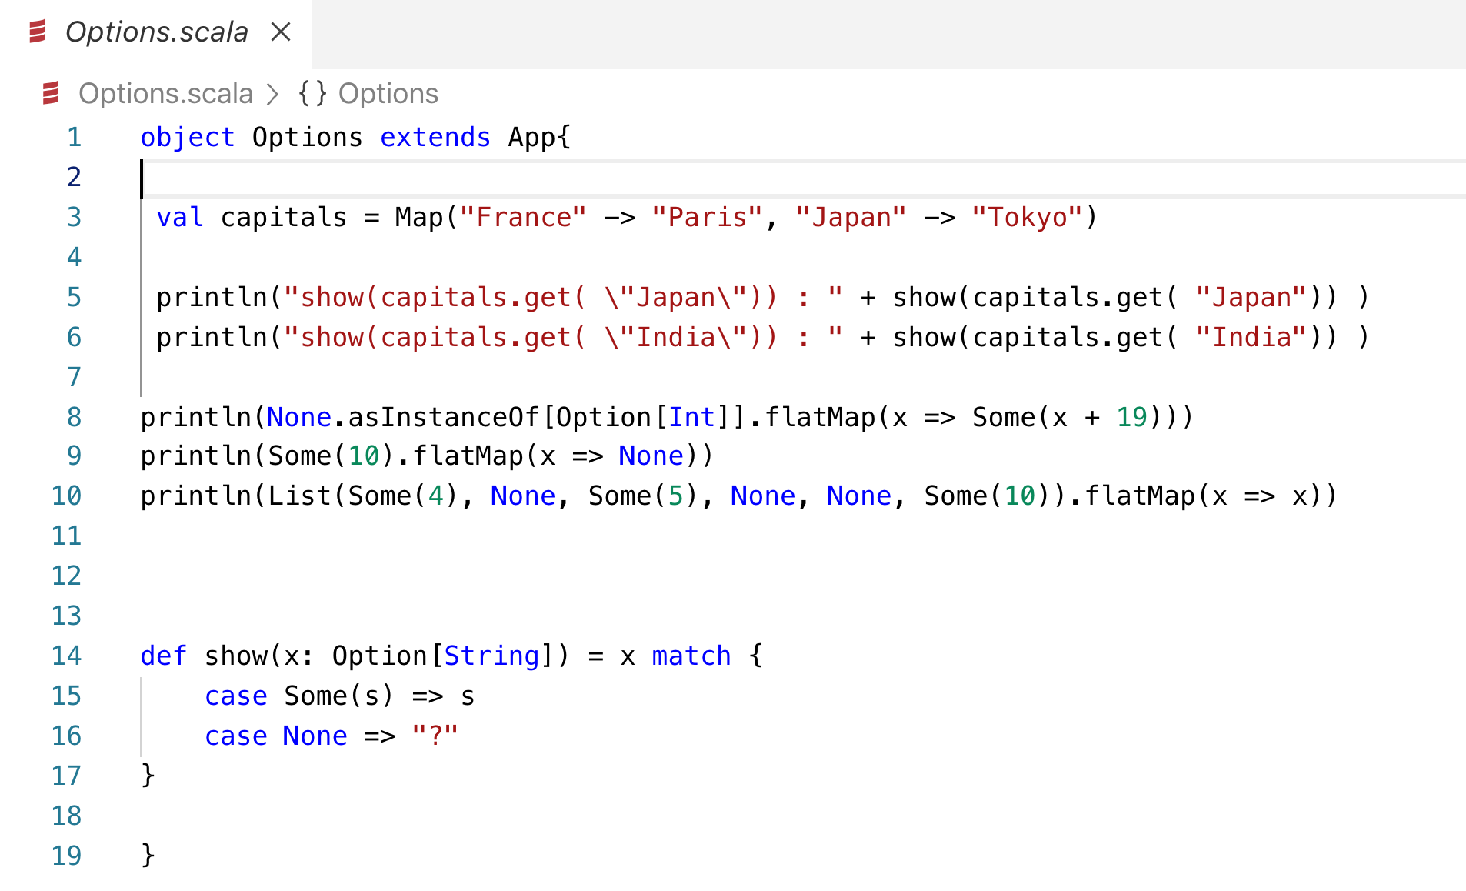

Slide 19
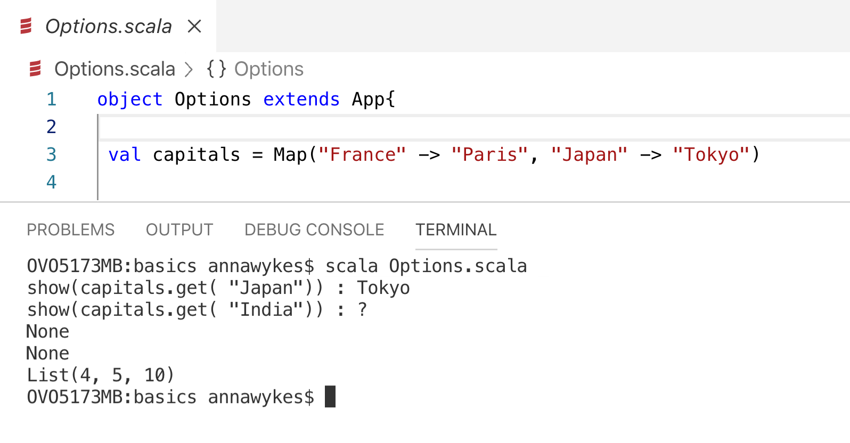

Slide 20
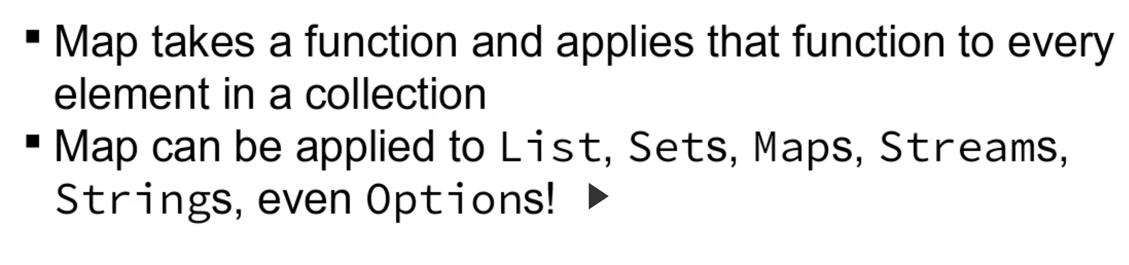
Map

Slide 21
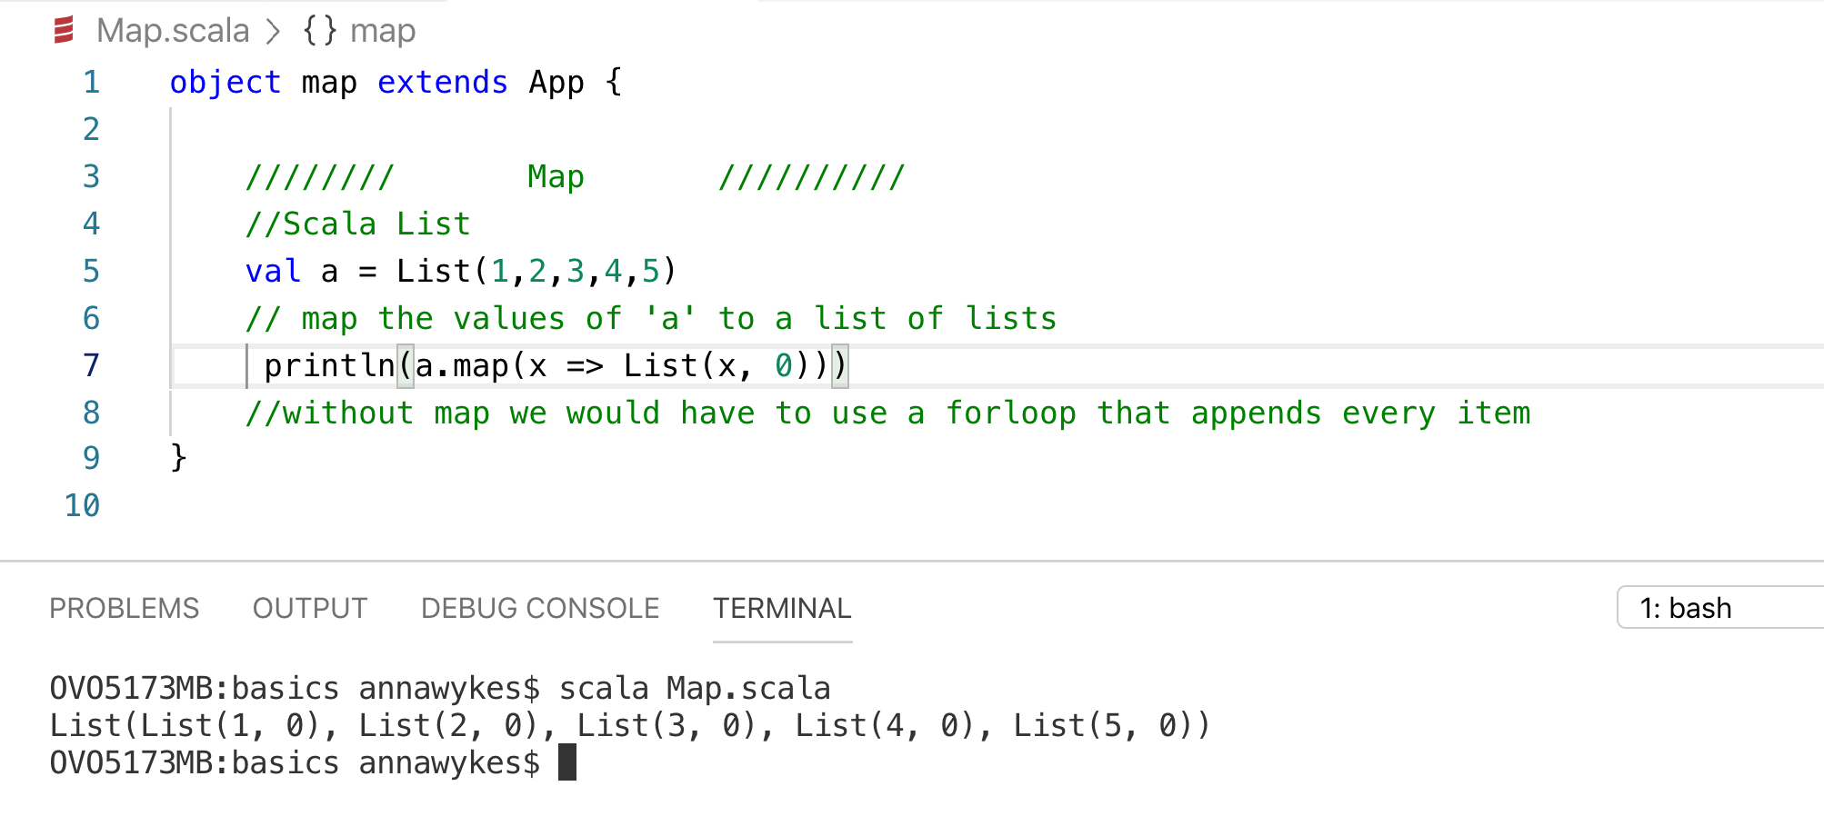

Slide 22
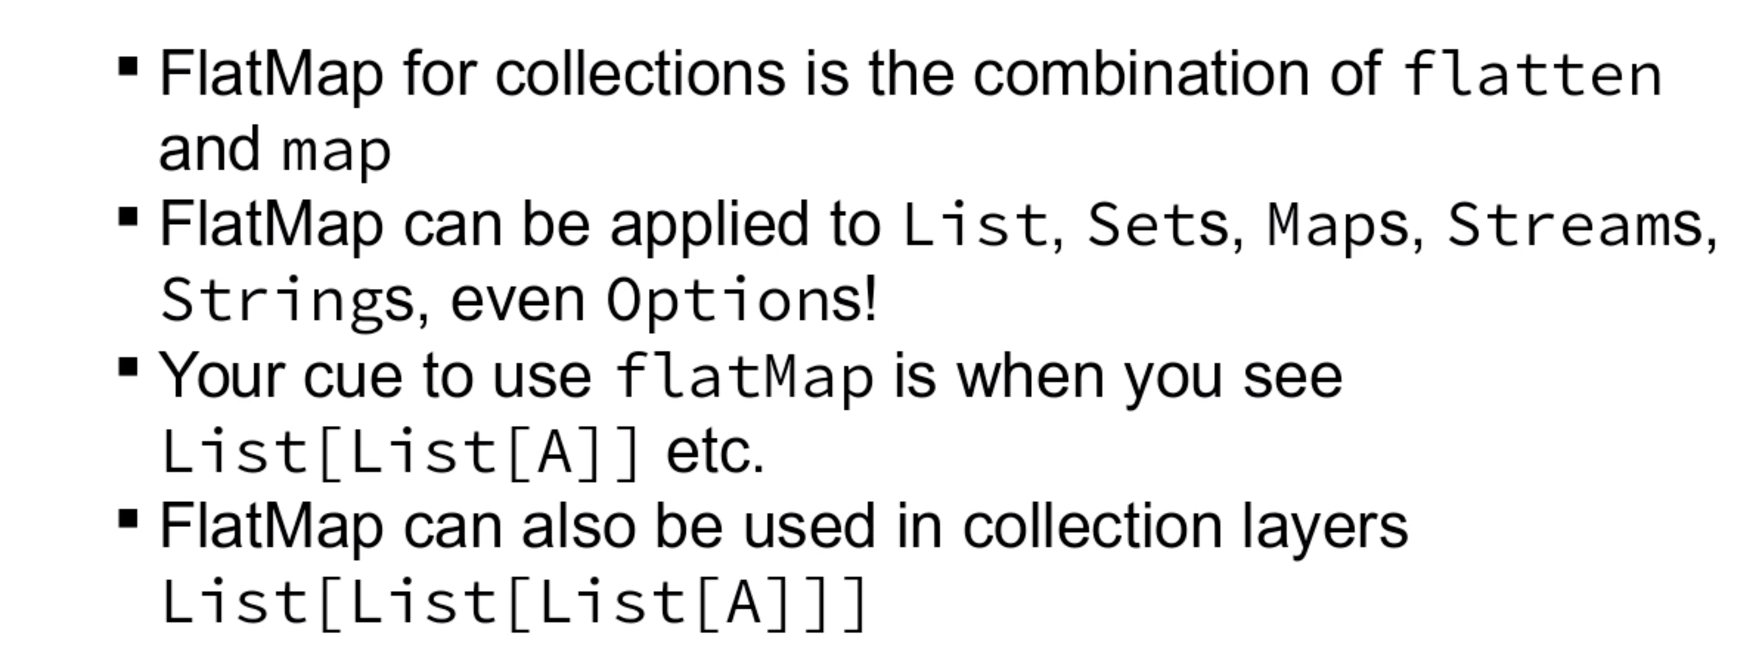
flatmap

Slide 23
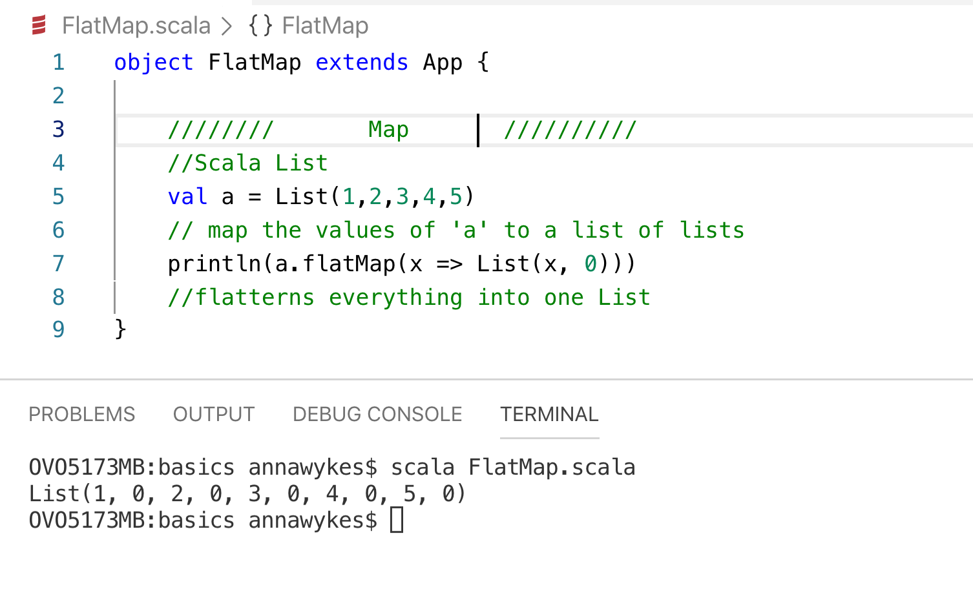

Slide 25
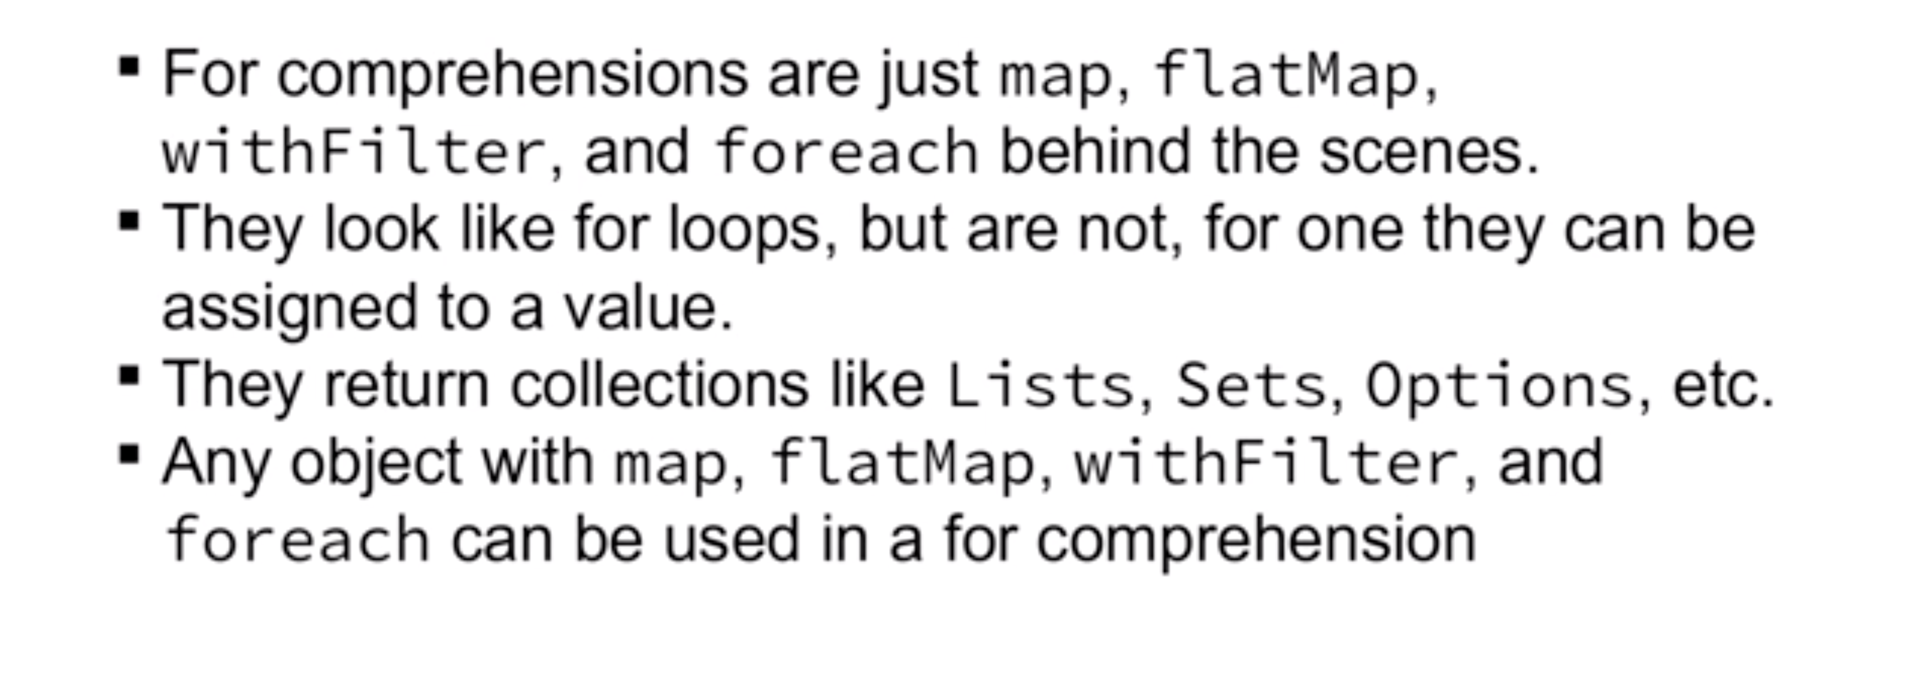
For Comprehensions

Slide 26
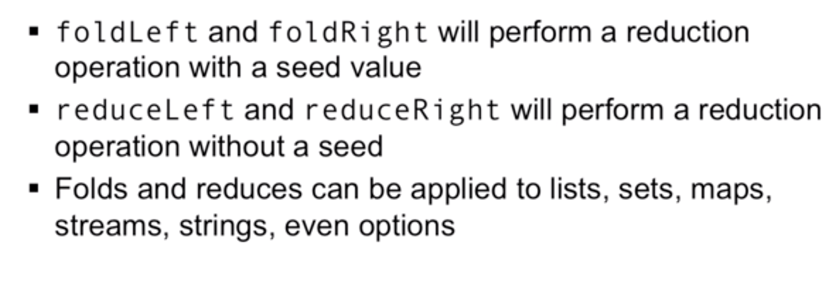
Fold and reduce

Slide 28
The Problem
Third party API providing old school XML responses that need to be transformed into JSON and then
Written to an Event queue
Stored in Data Lake

Slide 29
Demo Time: Read data source
Read XML and ouput JSON using:
Azure Function
Monad (Functional programming style)
Make sure you have JDK 8 installed and your JAVA_HOME set appropriately.
Install .NET Core (needed for the local function host)
Install the Azure Function Core Tools (this will help you run and debug your function locally before deploying)
Install sbt
https://github.com/AnnaWykes/scalaforbigdata

Slide 30
Data Bricks
DataBricks is an organization and big data processing platform founded by the creators of Apache Spark.
DataBricks was founded to provide an alternative to the MapReduce system and provides a just-in-time cloud-based platform for big data processing clients.
DataBricks was created for data scientists, engineers and analysts to help users integrate the fields of data science, engineering and the business behind them across the machine learning lifecycle. This integration helps to ease the processes from data preparation to experimentation and machine learning application deployment.

Slide 31
Demo Time: Time to refine Our Data
Move data from raw folder in Data Lake into refined folder

Slide 32
Useful Links

